Slide 1


Unit 6
HHFA planning and implementation activities
Notes:
Welcome to Unit 6 of Module 3.
In this unit, we will look at the 6 phases of the HHFA planning and implementation activities.
This unit highlights key aspects of the HHFA planning and implementation summary table, available as a pdf. Please refer to this document for the detailed list of planning and implementation activities within each phase.

Slide 2
By the end of this unit, you will be able to:
describe the 6 phases of the HHFA planning and implementation activities
Notes:
By the end of this unit, you will be able to describe the 6 phases of the HHFA planning and implementation activities.

Slide 3
HHFA planning and implementation activities
1
2
3
4
5
6
7
Decide information needs
Adapt questionnaire & CSPro tool
Train data collectors
Collect data
Analyse data
Interpret, communicate & use
Curate data
Plan, prepare and manage (detailed activities)
Notes:
To support the 7 key HHFA steps, and to ensure that quality data will be obtained from the survey, detailed planning and implementation activities are needed.

Slide 4

HHFA planning and implementation activities
The HHFA involves the collection of a vast amount of data in a high number of health facilities.
The HHFA must address:
methodological issues
operational constraints
Notes:
The HHFA involves the collection of a vast amount of data in a high number of health facilities.
Like all complex surveys, the HHFA must address both:
methodological issues; and
operational constraints in the implementation.
Thorough planning, preparation and management can help to ensure sound survey methodology and minimize constraints.

Slide 5
HHFA: 6 phases
The detailed planning and implementation activities are grouped into 6 phases:
A
D
Data review and description
Planning and preparation
B
E
Data interpretation and communication
Data collection
C
Data processing and analysis
F
Data curation
Notes:
The detailed planning and implementation activities are grouped into 6 phases:
A. Planning and preparation;
B. Data collection;
C. Data processing and analysis;
D. Data review and description;
E. Data interpretation and communication; and
F. Data curation.
We will now highlight key aspects of each of these phases.

Slide 6
Phase A: Planning and preparation
During Phase A, two types of decisions and tasks are required:
Strategic
Operational/Management
Convening stakeholders
Updating the Master Facility List
Defining the survey objectives
Adapting the questionnaire and CSPro tool
Designing the survey methodology
Recruiting and training survey personnel
Notes:
During this phase, two types of decisions and tasks are required:
Strategic, such as:
convening stakeholders;
defining the survey objectives, and
designing the survey methodology.
Operational or managerial, such as:
updating the Master Facility List;
adapting the questionnaire and CSPro tool; and
recruiting and training survey personnel.

Slide 7
Phase B: Data collection
In this phase, multiple teams are deployed to collect data in health facilities in many locations.
Data collection requires:
To ensure that:
logistical planning
all required facilities surveyed
management
quality data are collected
monitoring
data are transmitted to the HHFA server
Notes:
In this phase, multiple teams are deployed to collect data in health facilities in many locations.
Data collection requires detailed logistical planning as well as strong management and monitoring.
This is to ensure that all required facilities are surveyed, and that quality data are collected and transmitted to the HHFA server.

Slide 8




Phase C: Data processing and analysis
data collection complete
data cleaned in CSPro
data analysis platform
standard analysis outputs
Notes:
Once data collection is complete, the data set is checked and cleaned in CSPro.
The final data set is then uploaded to the HHFA data analysis platform.
The data analysis platform produces standard analysis outputs in the form of tables and graphs.

Slide 9

Phase D: Data review and description
It is important to conduct a comprehensive initial review of ALL the HHFA data analysis platform outputs, to have a preliminary overview of the major findings.
Notes:
It is important to conduct a comprehensive initial review of ALL the HHFA data analysis platform outputs, to have a preliminary overview of the major findings.

Slide 10
Phase D: Data review and description
Review of the data analysis platform outputs involves three stages:
1
Understanding the structure of the tables and graphs
2
Understanding what the data reveal
3
Describing and summarizing the initial findings
Notes:
Review of the data analysis platform outputs involves three stages:
Understanding the structure of the tables and graphs;
Understanding what the data reveal; and
Describing and summarizing the initial findings.

Slide 11
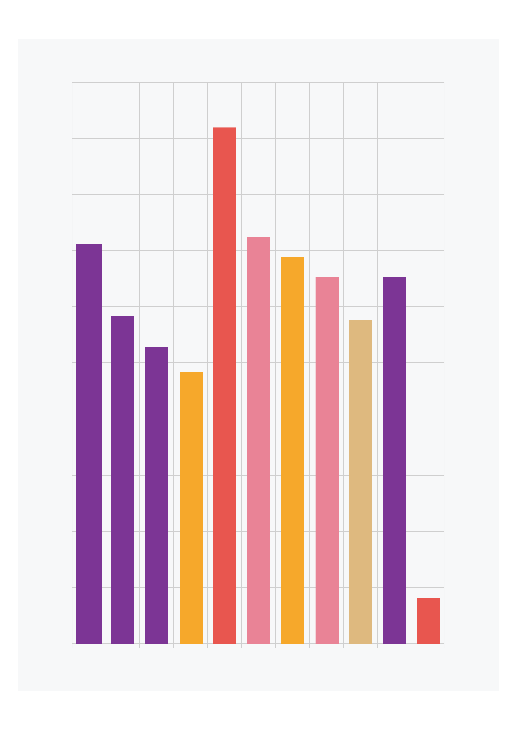
Phase E: Data interpretation and communication
Data interpretation aims to understand:
what the data mean in the country context
the reasons behind the findings
Notes:
Data interpretation aims to understand what the HHFA data mean within the country context and to explore the reasons behind the findings.

Slide 12
Phase E: Data interpretation and communication
Data review
Data
interpretation
cycle
Further data analysis
Use of contextual information
Consultation with experts
Data triangulation
Notes:
Data analysis, review and interpretation are not a sequential, linear process, but rather an iterative cycle of:
data review;
using contextual information;
looking at HHFA data in relation to other data sources (also called “data triangulation”);
consulting with experts; and
conducting further analysis of the data, as needed.

Slide 13
Phase E: Data interpretation and communication
Data review
Several interpretation cycles may be needed to:
Further data analysis
Use of contextual information
gain a comprehensive understanding of HHFA data
identify and prioritise key strengths and weaknesses
Consultation with experts
Data triangulation
make relevant and realistic recommendations
Notes:
Several interpretation cycles may be needed to:
gain as comprehensive an understanding of HHFA data as possible ;
identify and prioritise the key strengths and weaknesses;
make relevant and realistic recommendations.
The outputs of the interpretation process will form the basis of the final HHFA report.

Slide 14

Phase E: Data interpretation and communication
Communication of HHFA findings
Important for acceptance and use by decision-makers
Notes:
The ways in which the HHFA findings are communicated are important for their acceptance and use by decision-makers.

Slide 15
Phase E: Data interpretation and communication
HHFA communication products:
HHFA final report
policy briefs
programme-specific reports
presentations
Notes:
The final HHFA report is the main communication product.
Other products can be developed based on the needs of different audiences, for example, policy briefs, programme specific reports, and presentations

Slide 16

Phase F: Data curation
Data curation
Cataloguing and archiving the HHFA dataset and related documentation so that they can be accessed for future use.
Countries may use the WHO global HHFA archive.
Notes:
Data curation consists of cataloguing and archiving the HHFA dataset and related documentation in a secure location, so that they can be accessed for future use.
WHO has developed a global HHFA archive where countries may choose to securely store their facility survey data and documentation.

Slide 17
You have now completed Unit 6.
Now try the end-of-module quiz.
Notes:
You have now completed Unit 6.
Now try the end-of-module quiz.

